Slide 1
PREDICTING PROCEDURE TIMES

Slide 2
Problem
Medical procedure scheduling is often times mostly a crapshoot
It is very easy for procedures to get backed up, and waiting times of several hours for the patients, causing some to leave
Doctors can also be to fast, causing on missed opportunities to schedule extra patients
Procedures can be very expensive so scheduling well saves $

Slide 3
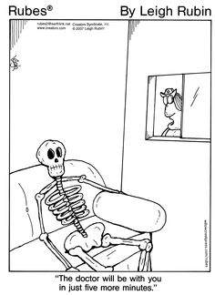

Slide 4
Objectives
Eventually I want to predict the total time in the room for each patient
Total time is measured in minutes (Time Patient Exits Room –Time Patient Enters Room)
I will measure my score in RMSE

Slide 5
Data Source
I got my data, procedure information from one Spinal Intervention Specialist at Fresno Surgery Hospital for the past year
The data is given in a clumsy text format which was a headache to clean, however eventually all data is mapped to a clean csv-file
Much of the data had to be deleted because features were missing.
Only 671 Rows after this data was deleted – very small!

Slide 6
DATE: 10/04/16 @ 1352 Fresno Surgical Hospital SCH LIVE PAGE 1
USER: GARBMI Procedure Times by Surgeon/Date with Patient Demographics
Date Account Number Age Gender ASA Class BMI Procedure Name Into Rm Start End Procedure Time Out of Room
01/04/16 V185428 64 F 34.0 LEFT LUMBAR MEDIAL BRANCH RADIOFREQUEN.. 1123 1137
Coded Allergy:
NO KNOWN DRUG ALLERGIES
CODEINE
ASPIRIN
Uncoded Allergy:
CPT Code ICD-10 Code Insurance
64635 M47.816 BLUE SHIELD HMO
64636 G54.4
M51.36
M51.06
M96.1

Slide 7
Features
Procedure: The type of procedure being formed, aka ‘Facet Joint Injection’
Two columns for procedure, a specific procedure and a more generalized feature – IE: Lumbar ESI vs ESI or Cervical Radiofrequency vs Radiofrequency
CPT Codes: What the doctor actually bills for and gets paid for, can be multiple codes per procedure
Ex: ['64640', '63650', '64634‘]
Demographic Data –Ex: Age, Gender etc..
Specific procedure Data, Ex: What was the month of the procedure? Was there one or two rooms available?

Slide 8
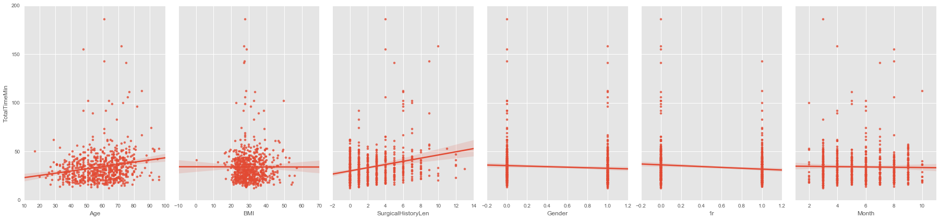
Demographic/Specific data does not seem to be very predictive:

Slide 9
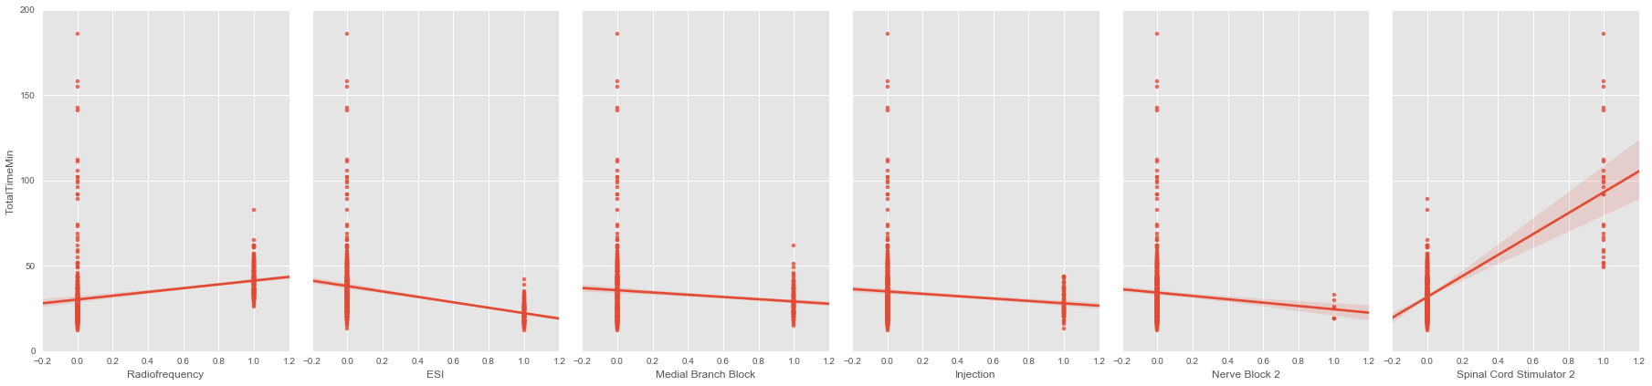
…Procedures are better

Slide 10
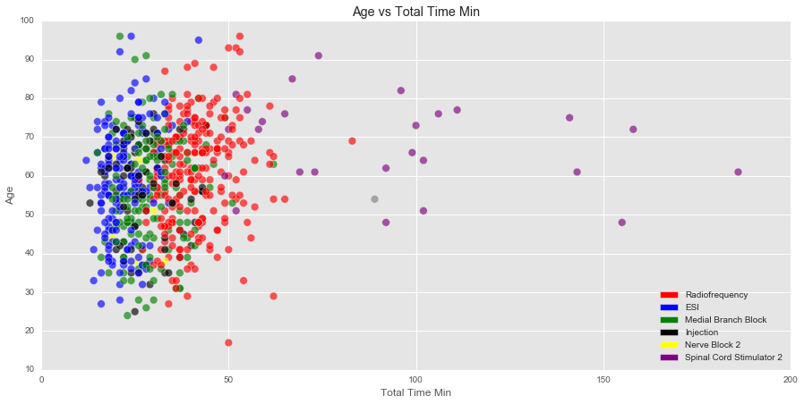

Slide 11
Spinal Cord Stimulators take a while!

Slide 12
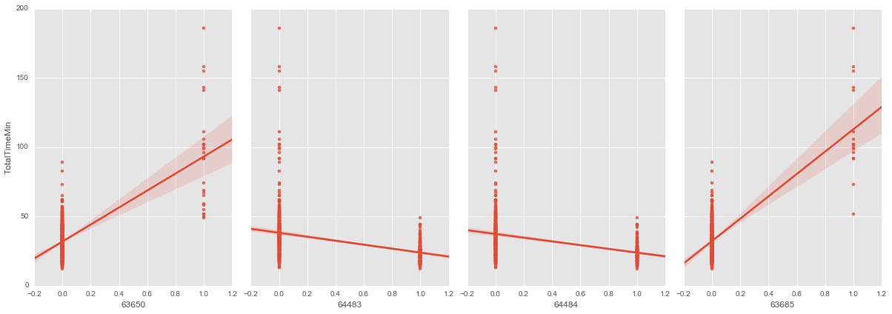
However … CPT codes are best

Slide 13
Average values and Null Accuracy
Average Time of Entire Dataset: 34.18 MIN
Null score is using the average value:
RMSE : 17.04
ABS: 11.06
Tougher Null Score using average lengths of procedures:
RMSE: 10.23
ABS: 6.62

Slide 14
Algorithm Selection
My most competitive algorithms were Linear Regression, or combinations of Linear Regression, SGD and KNN ensembled
Random Forests did not work as well because of small # of samples
To create the ensemble I used the predictions of some combination of Linear Regression, KNN and SGD as features which I fed into a another Linear Regression Algorithm

Slide 15
Ensemble Creation
Predictions
KNN
K Best Features
Linear Regression
Predictions
KNN, SGD or Linear Regression
Final Predictions
SGD
Predictions

Slide 16
Feature Selection
I used stepwise feature selection, selecting the ‘Kbest’ features at 1, 2,3,4 # of features… and so on
feature_cols = ['64640', '63650', '64634', '64480', '64635', '64636', '64484', '20605', '63685', '63688', '62311',
'62310', '63661', '64494', '64495', '64633', '64490', '64491', '64492', '64493', '64450', '27096',
'Gender', 'Age', 'F17', '3', '1r', 'ESI', 'Lumbar Radiofrequency', 'Nerve Block 2', 'Radiofrequency']
X = dfNotNull[feature_cols]
y = dfNotNull['TotalTimeMin']
for i in range (1, len(feature_cols)+1):
#gridsearch with select kbest
neighbs_k = range(1, 30)
param_grid = dict(neigh__n_neighbors=neighbs_k )
neigh = KNeighborsRegressor()
filter1 = SelectKBest(k=i) # select the best 2 features
pipe = Pipeline([('anova', filter1), ('neigh', neigh)])
grid1 = GridSearchCV(pipe, param_grid, cv=5, scoring='mean_squared_error').fit(X,y)

Slide 17
Feature Selection
Unfortunately, when I tried to use the features I got with the select K best feature selection again in another algorithm, I would get huge RMSE’s
Ex: 8.9 vs 120,208 - Over 10,000x my first result!!!
This is most likely due to highly correlated features in the dataset, which ‘Select Kbest’ does not catch every time
To combat this I added up the list of the features used most by select Kbest(Thanks Sinan!!)

Slide 18
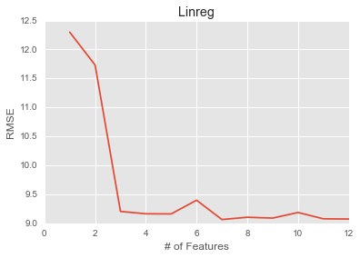
Best Choice: 7 features, 9.06 RMSE

Slide 19
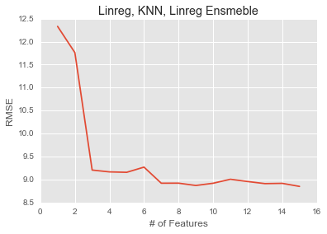
Best Choice: 7, Features 8.92 RMSE

Slide 20
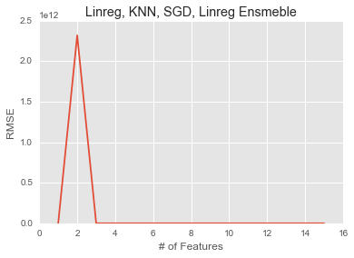
Huge increase with the addition of CPT code '63650'
Best Choice 7 Features 8.82 RMSE

Slide 21
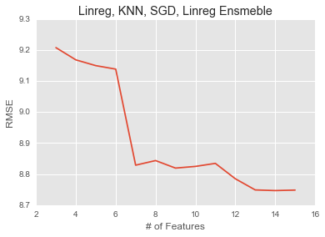
Best Choice 7 Features 8.82 RMSE

Slide 22
Final Features
I chose the Linreg, KNN, SGD Ensemble method as it had the lowest value at 7 features
The final features I found are: ['63685', '63650', 'Radiofrequency', 'Lumbar Radiofrequency', '64636', '64635', 'ESI‘, ‘1r’ ]
All CPT-Codes or procedure names except ‘1r’ which tells whether there is one or two rooms on that day, which I was told by the doctor was important.

Slide 23
Final Scores
My final RMSE is 8.8 –Beats null by 48%, Beats tougher null by 14%
My final Absolute Error Score is 6.13

Slide 24
Next Steps
Try to find exactly why I am getting such large RMSE values
Try feature clustering to see if that is helpful
Create a website with Heroku where the doctor can get predictions for each procedure
See if I can apply ordinal classification

